Slide 1
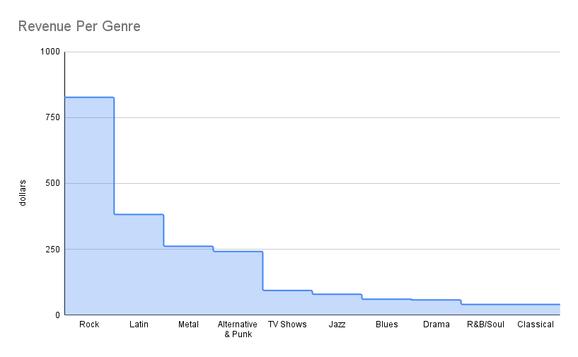
which music genre has the highest revenue?
<visualization>
Rock music represents 35% of the revenues with 826.65 dollars
Genre

Slide 2
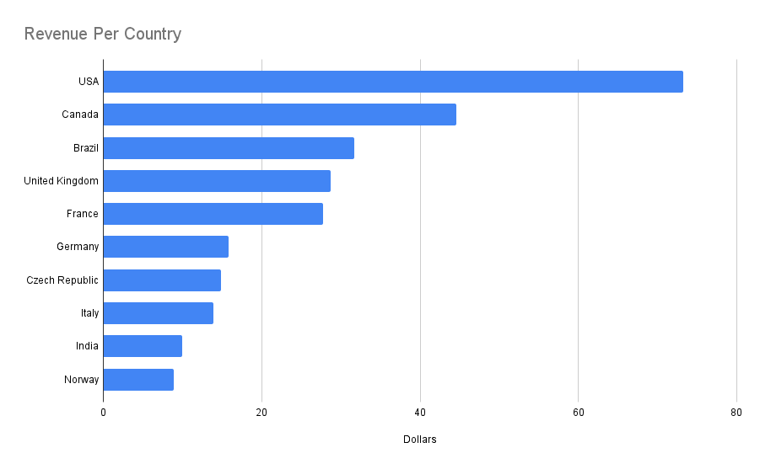
which contry has the highest revenue?
<visualization>
USA has the highest revenue with 73.26 Dollars
Country

Slide 3
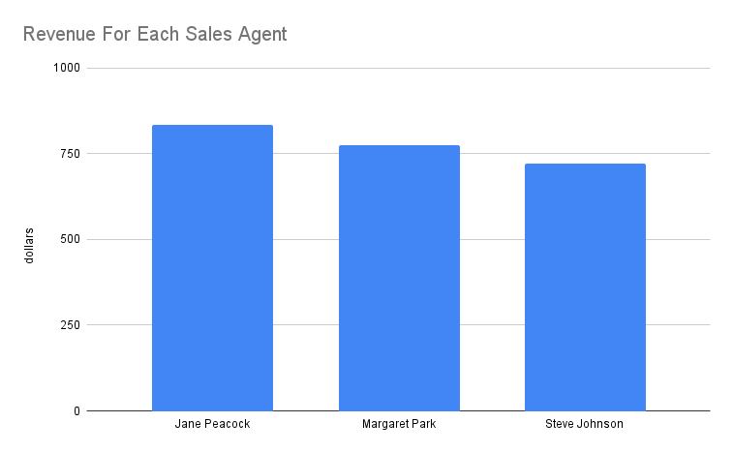
which sales agent scored higher sales?
<visualization>
Jane Peacock scored the highest revenue with 833.04 dollars
Sales Agent

Slide 4
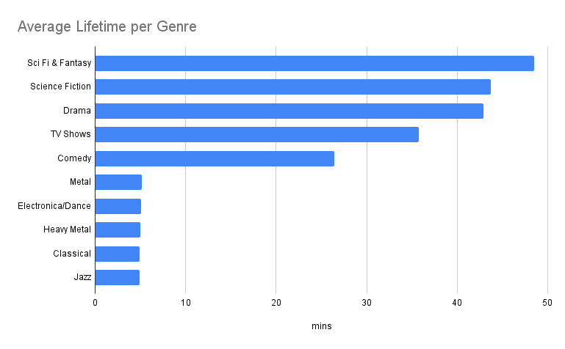
what is the average lifetime for every genre in mins?
<visualization>
the highest average lifetime is Sci Fi & Fantasy with 48.5 mins
Genre

